Slide 1
Ubiquitous and Mobile Computing CS 528: StudyMate Final Presentation
Michael Zeolla, Roman Wicky van Doyer, Emmanuel Ola, Adam Grabowski
Computer Science Dept.
Worcester Polytechnic Institute (WPI)
Notes:
‹#›
Roman

Slide 2

Problem Introduction
Students struggle to find other students to work and study with – and tutor them
Finding study partners with compatible schedules is tedious
New students struggle to assimilate into the school environment
Stressed Student [1]
Notes:
Roman

Slide 3
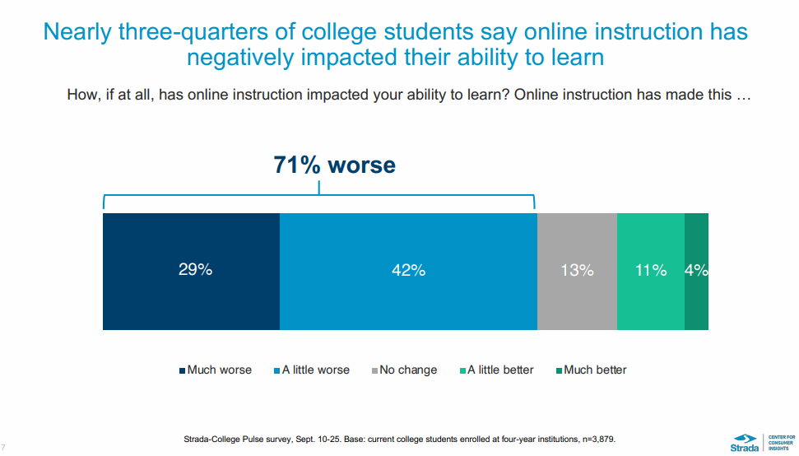
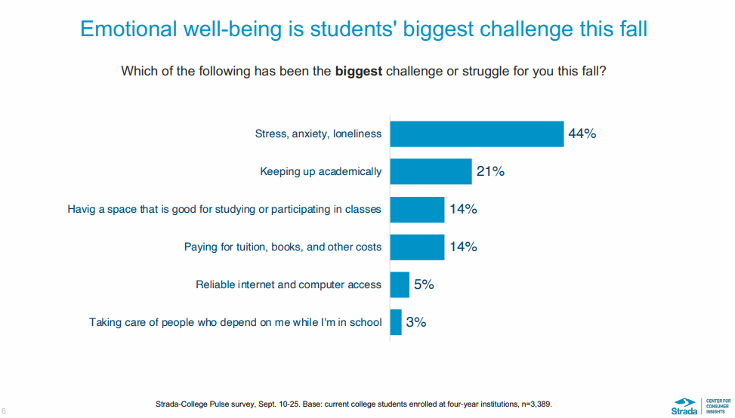
Why does it matter?
Students can struggle to organize study groups and finding other students with compatible schedules, adding to the overall stress of academic studies
Stress management
Keeping up Academically
Students believe online teaching is not valuable for their ability to learn [2]
Demand for more online resources to aid in learning
Notes:
Roman

Slide 4
Ubiquitous and Mobile Computing CS 528: StudyMate
Background Research
Notes:
‹#›
Roman

Slide 5



Related Work
Non-centralized solutions exist to this problem on a University level
Different programs, apps and etc. – WPI MASH
Different platforms offer (paid) tutoring services
Chegg Study, Learn To Be, Tutor Point, Duolingo
WPI MASH Session [3]
Notes:
Roman
Online services do a poor job of relating to the specifics of the university (professor, topics, etc.)
They are more broad and might not cover the exact topics from class
Apps exist to help people learn AND it is clear that people pay for them

Slide 6
Ubiquitous and Mobile Computing CS 528: StudyMate
Methodology
Notes:
‹#›
Adam

Slide 7
Methodology
Allow students to join their institution’s platform
Based on user location and geofenced university
Allow students to create study groups by classes
Study groups suggested to you based on your availability
Allow students to join study groups and chat within the groups
Use real-time chatting per group
Notes:
Adam

Slide 8
Methodology
Students can upload notes, then StudyMate can provide a brief synopsis of notes to other students
Text Recognition used to generate summary
Text Translation to alter language
Geofencing capabilities automatically suggest study groups on campus based on availability
Students in same university can group together
Notes:
Adam

Slide 9
Ubiquitous and Mobile Computing CS 528: StudyMate
Implementation
Notes:
‹#›

Slide 10









Technical Stack
Development Process
Agile Development
Git
Jira
Frontend
Android
Android Jetpack
Figma
Backend + APIs
Firebase
Google Maps API
Google Vision API
Notes:
Zeolla

Slide 11
Architecture
Fragment
ViewModel
State
Google APIs
Vision
Maps
Local Store
Cloud Data Service
Firebase
API
Notes:
-Zeolla

Slide 12

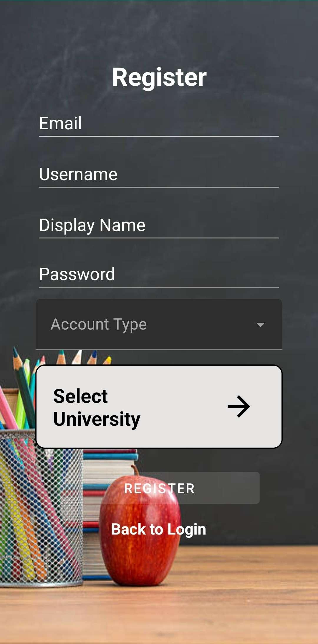
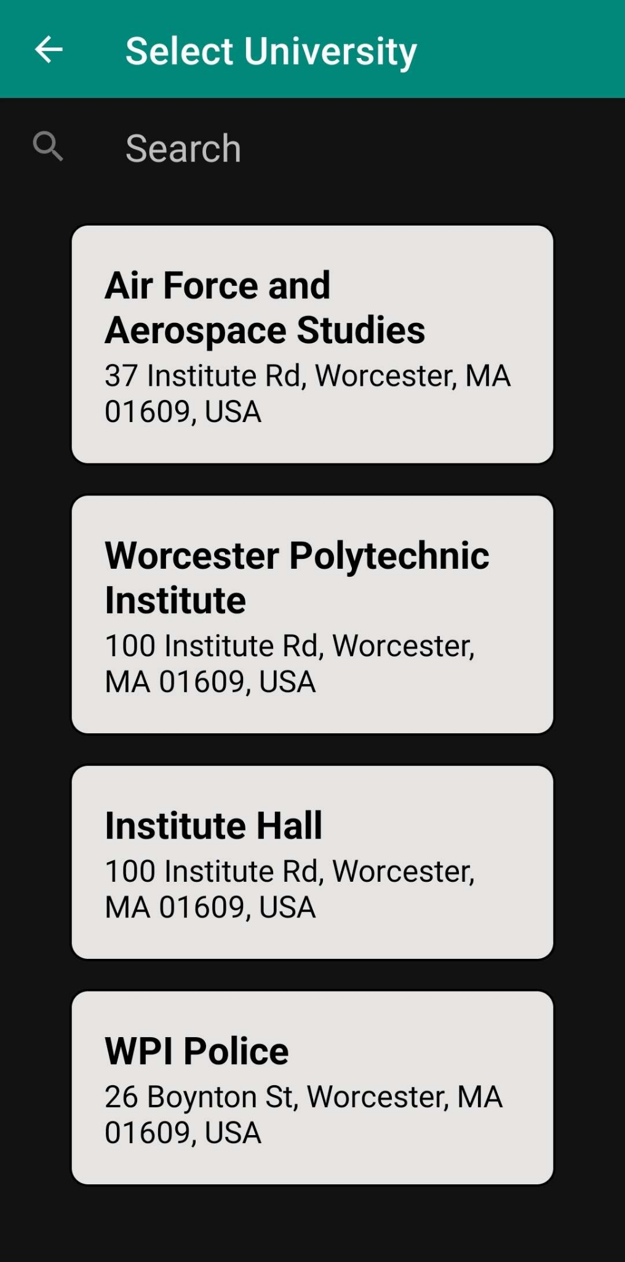
App Authentication - Firebase
Firebase Auth for authenticating users
Account Registration
Requires location (university) selection
Nearby Search + Places API for locating universities
User details stored in Firebase Firestore
Notes:
-Zeolla

Slide 13
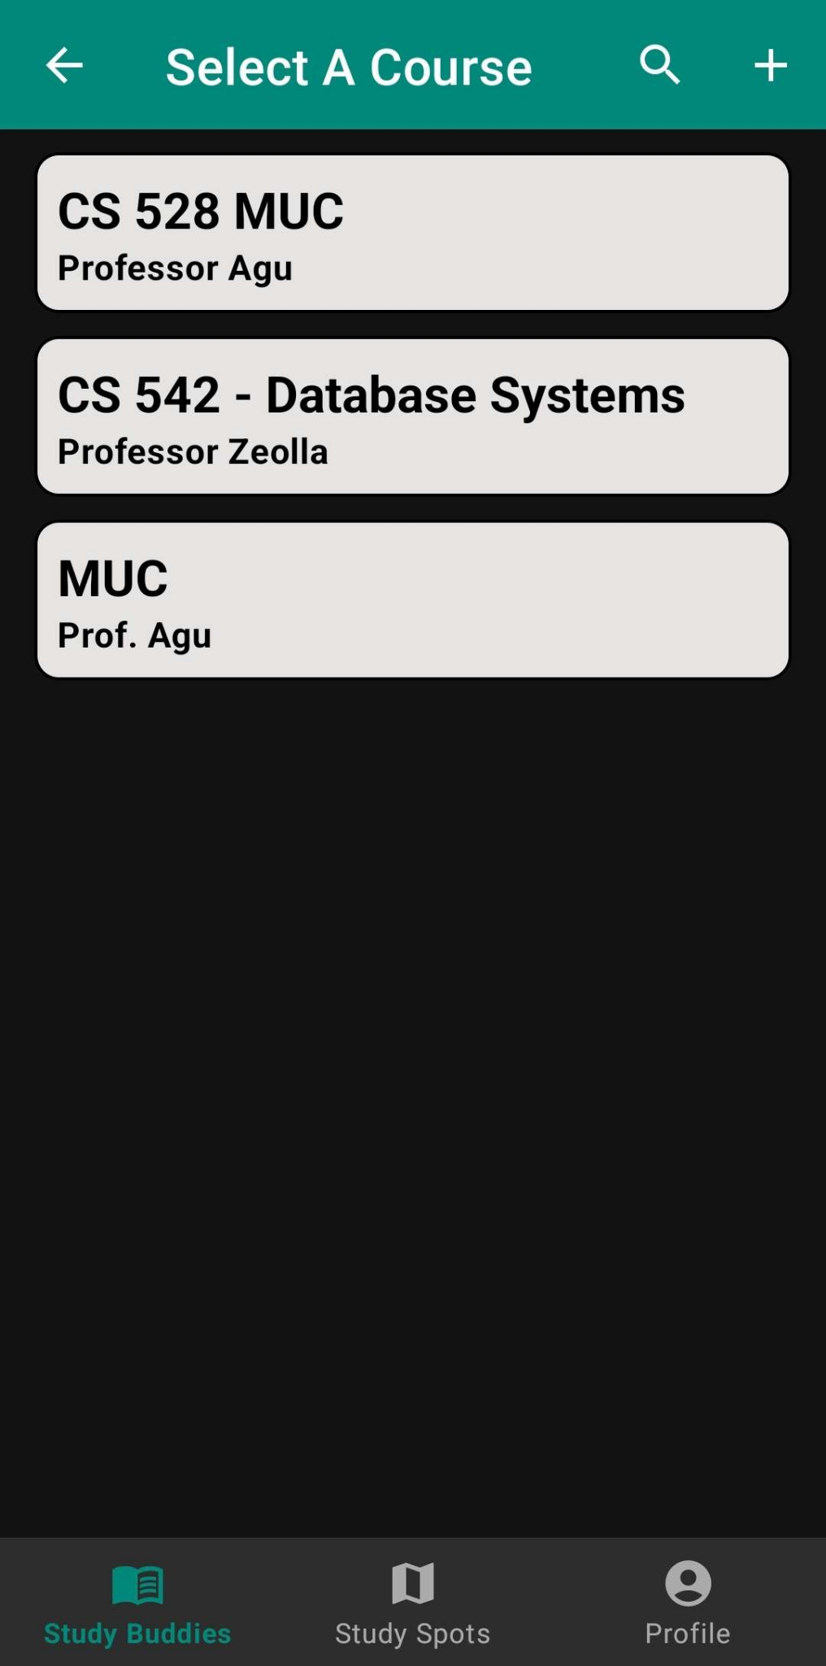
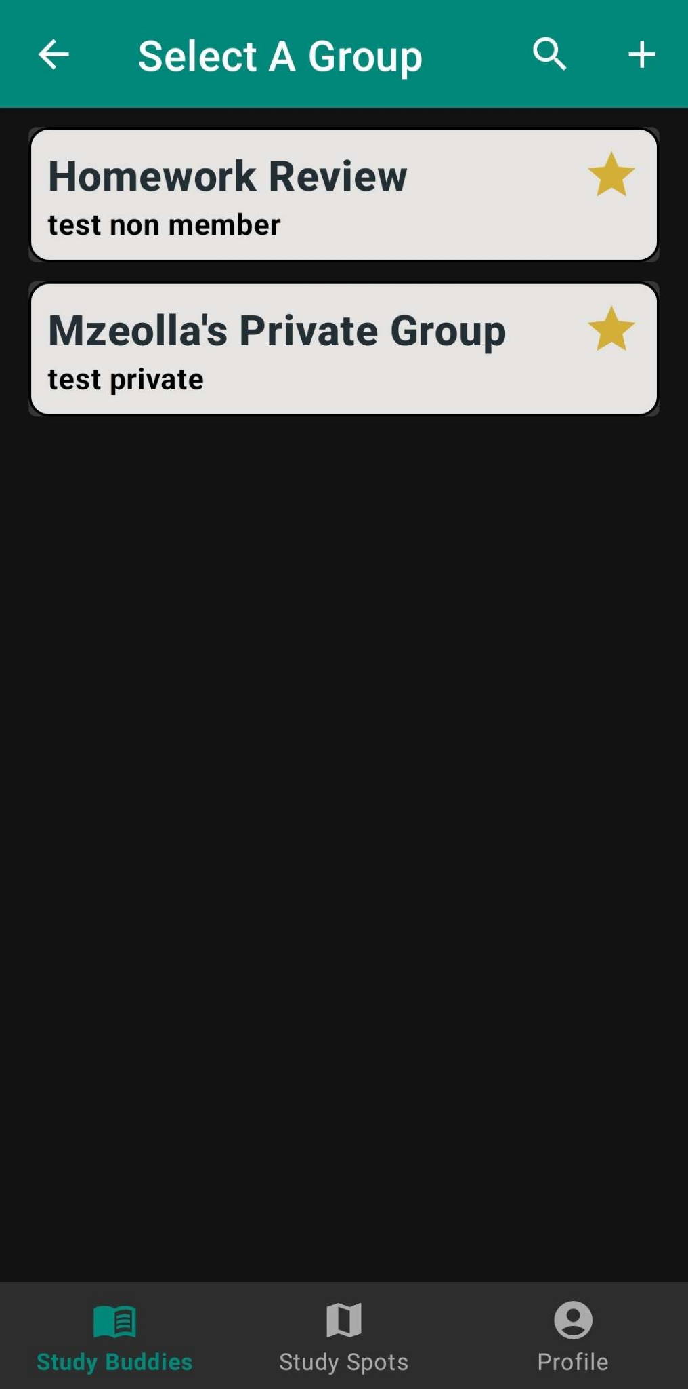
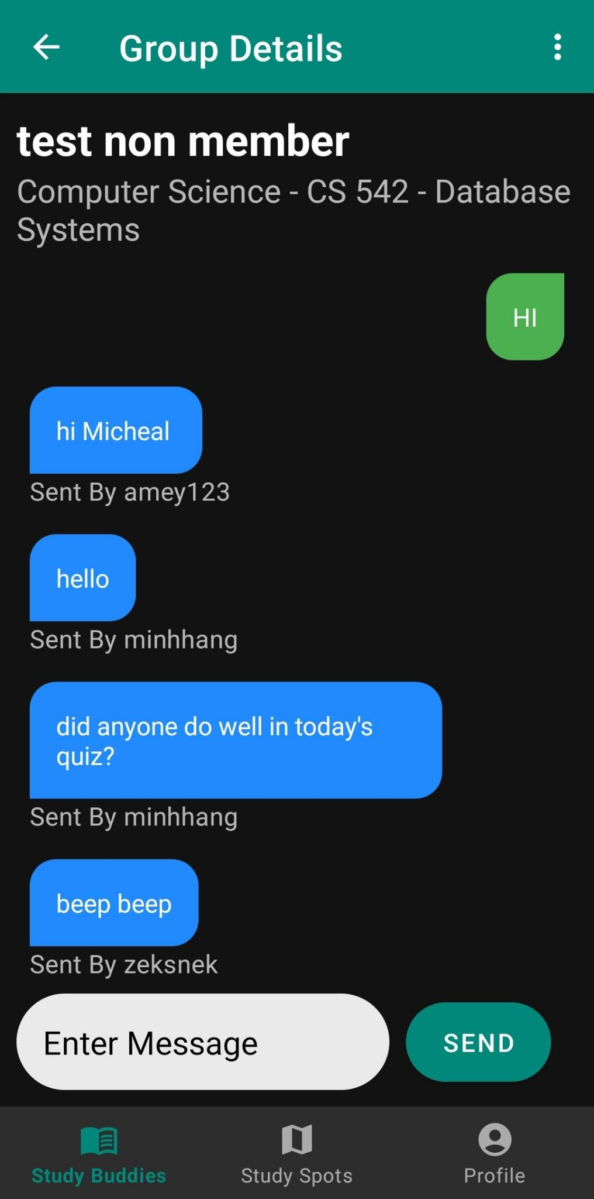
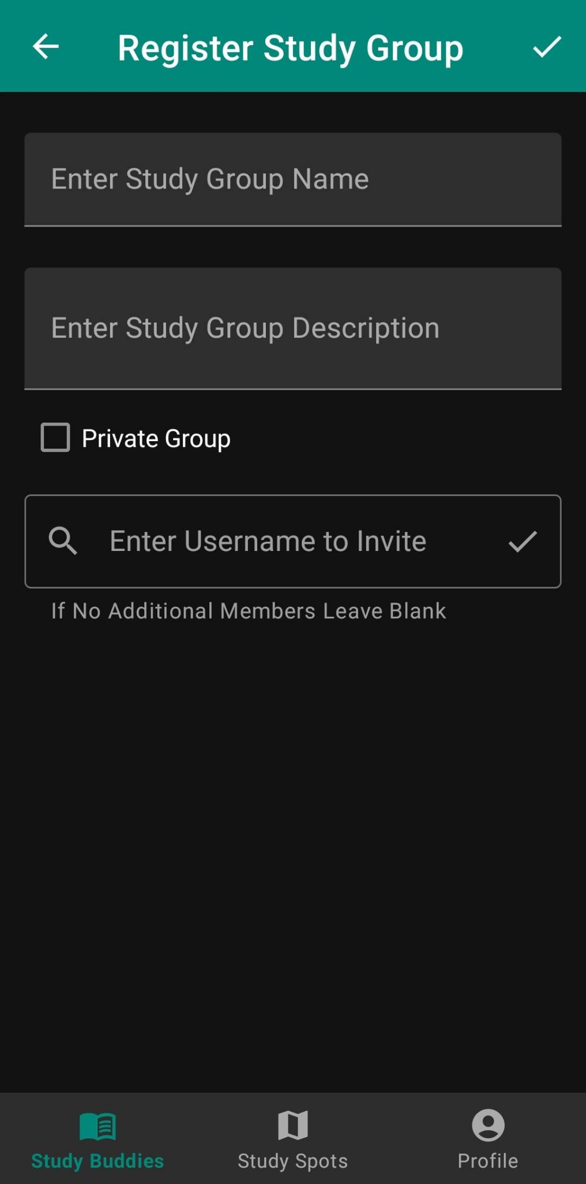
Study Buddies - Firebase
Find Study Groups based on Department, Course, etc.
Join and leave study groups via the simple UI
Live Chatting between all users
Schedule meetings for the entire group
Register new Courses and Study Groups
Notes:
-Zeolla

Slide 14
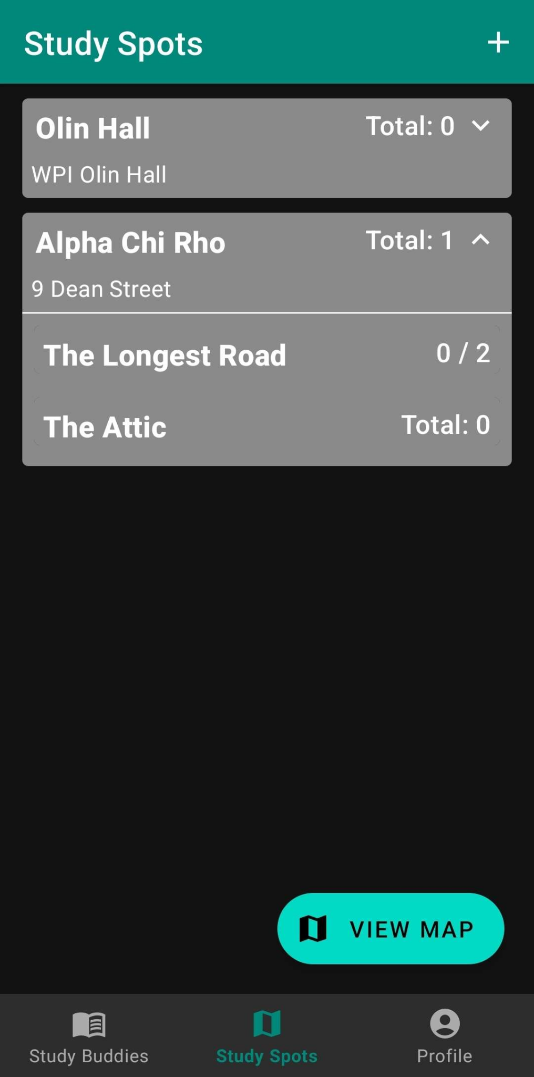
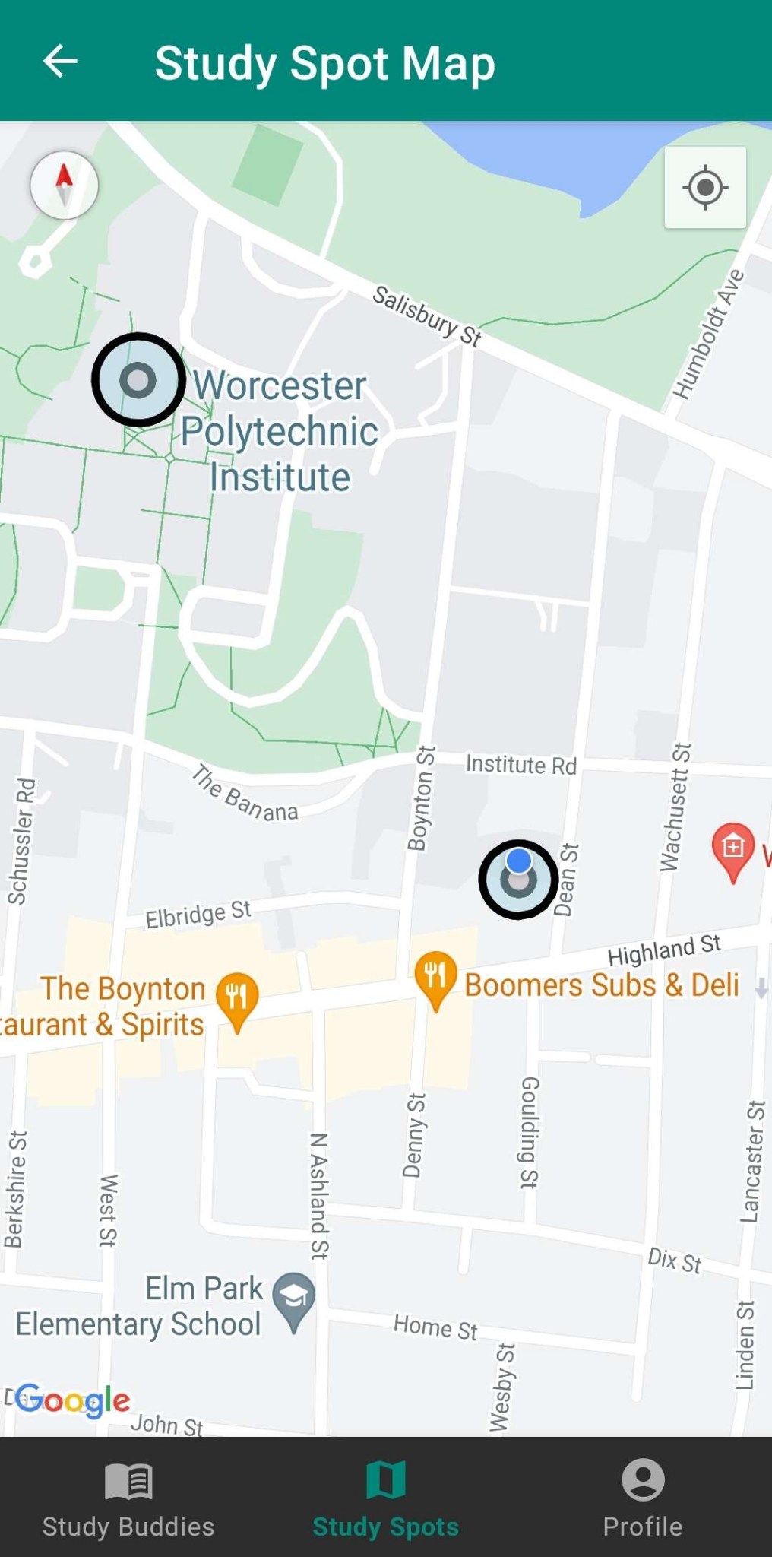
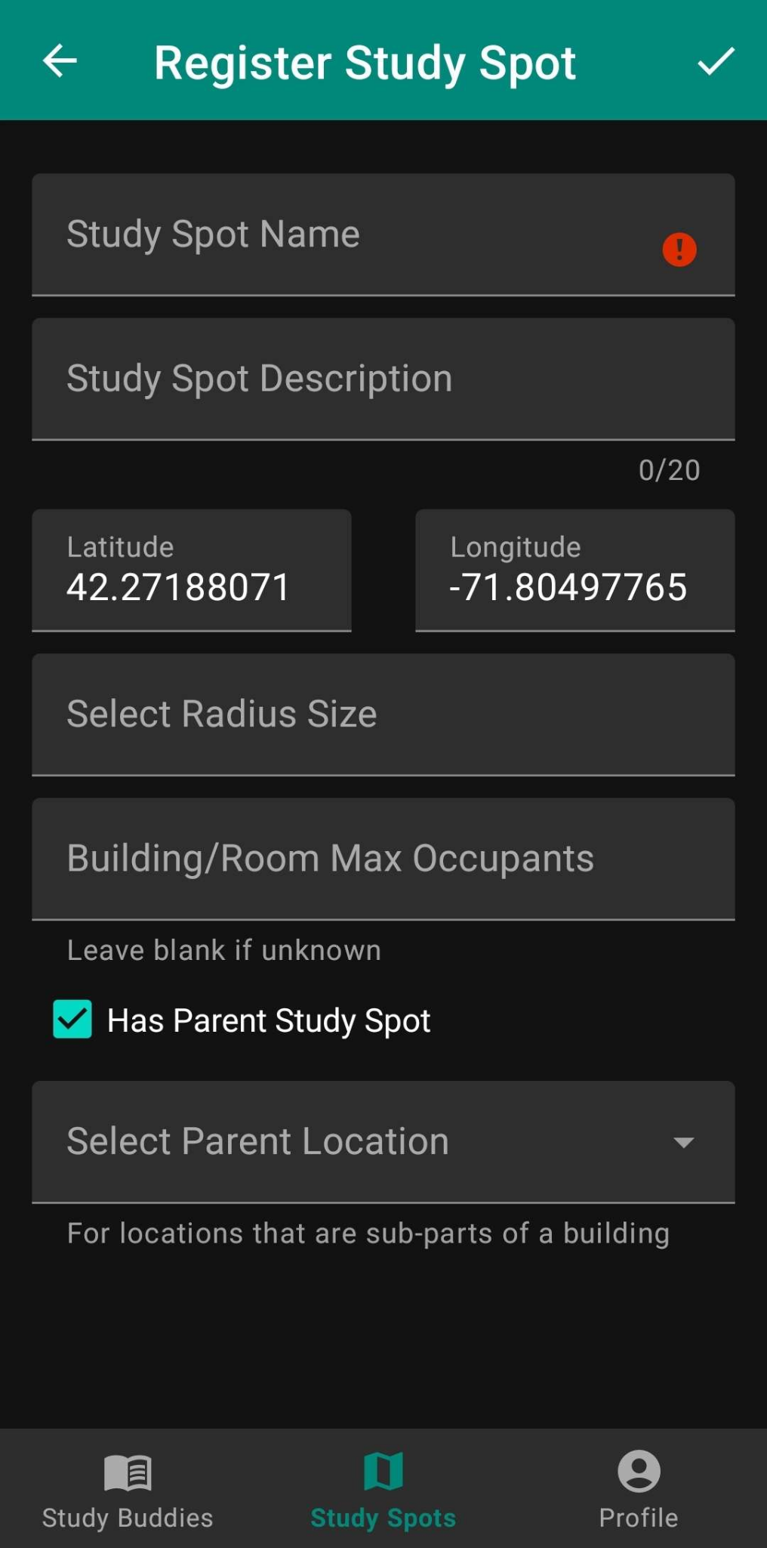
Study Spots - Geofencing + Firebase
View and Register location specific Study Spots
Track the number of users in Geofenced locations
Live updates when Entering and Exiting Study Spots
View a live map of ALL Study Spots (Geofences)
Register new Study Spots on campus
Notes:
-Zeolla

Slide 15
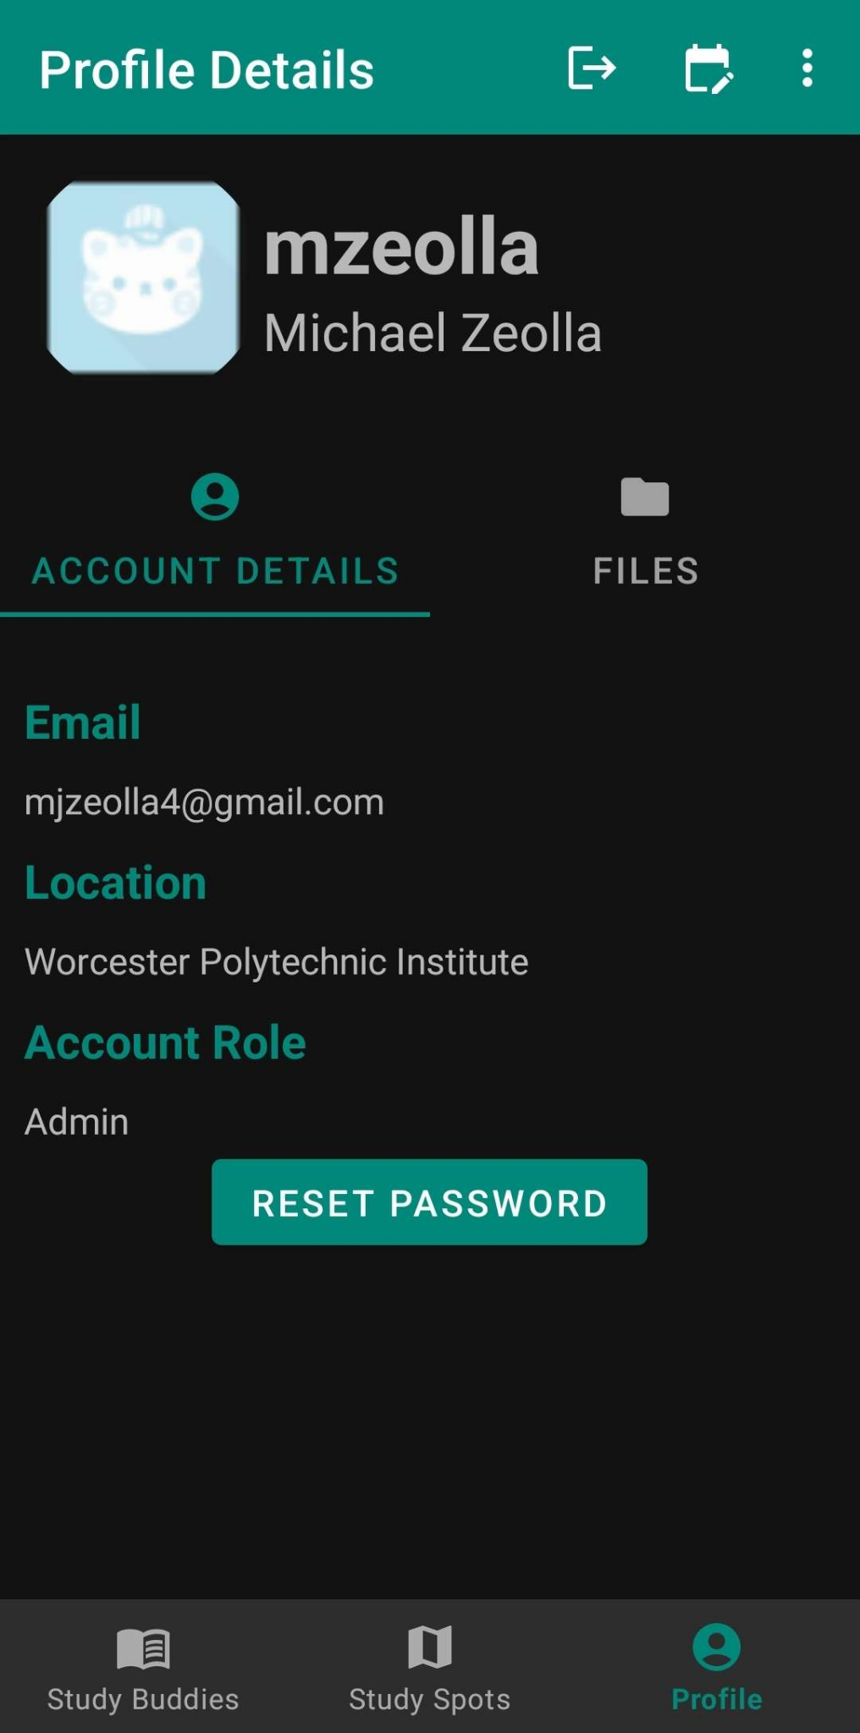
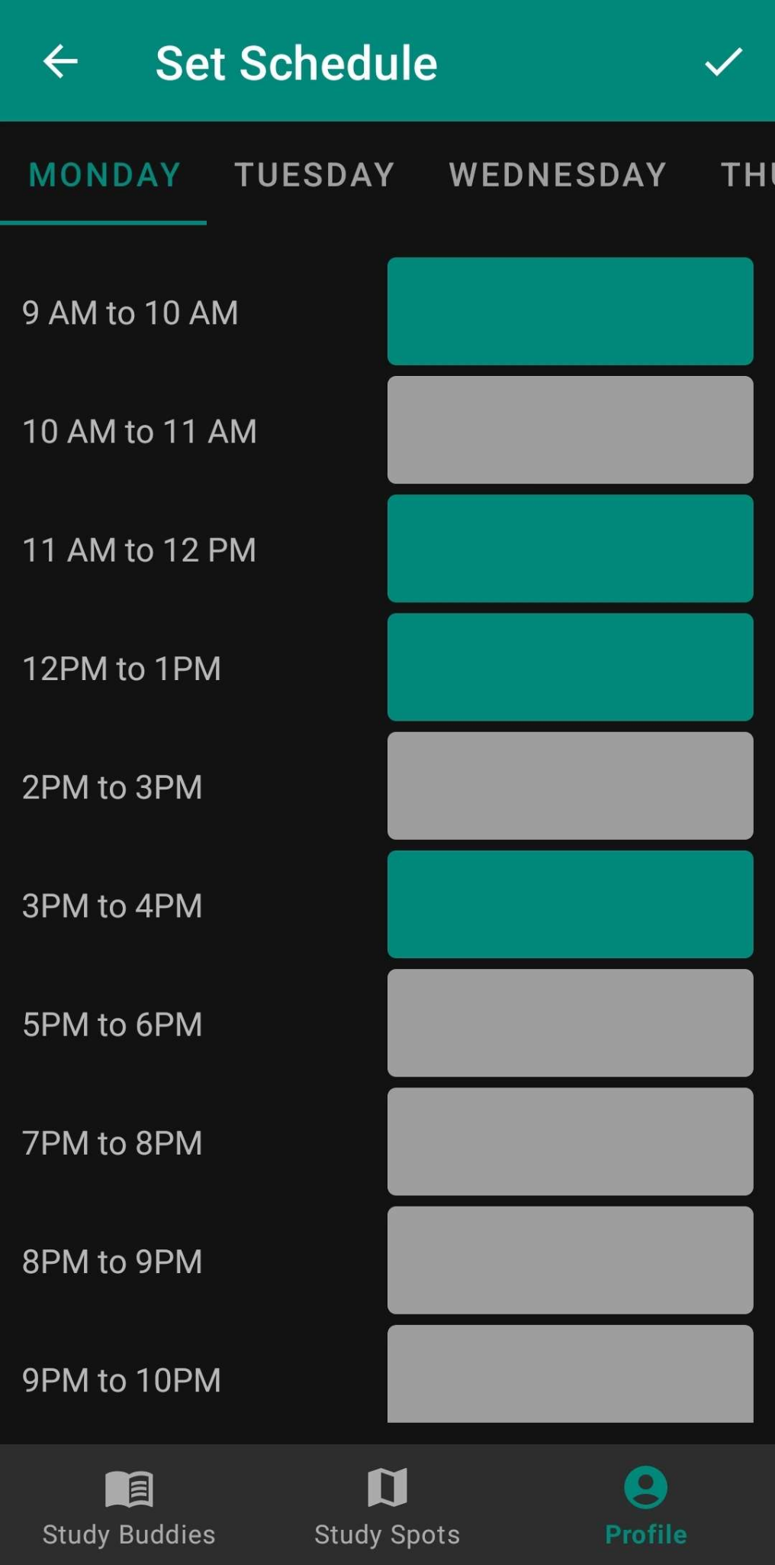
Profile Page - Firebase
View account related details via the Profile Page
View the Username, Display Name, Email, Role, and Location
Set your personal availability per week
Weekly availability is used to find the best match for Study Groups
Stored in Firebase, and can be updated in real time
Notes:
-Zeolla

Slide 16
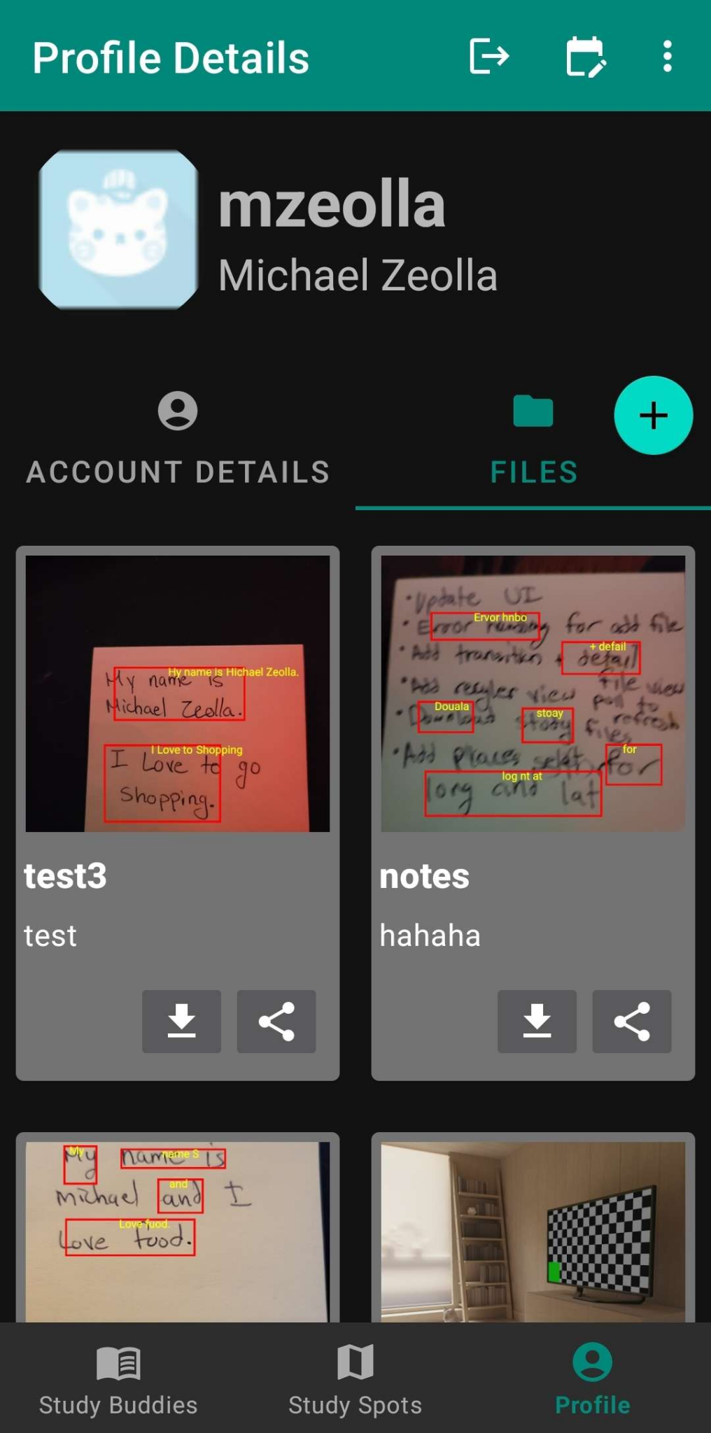
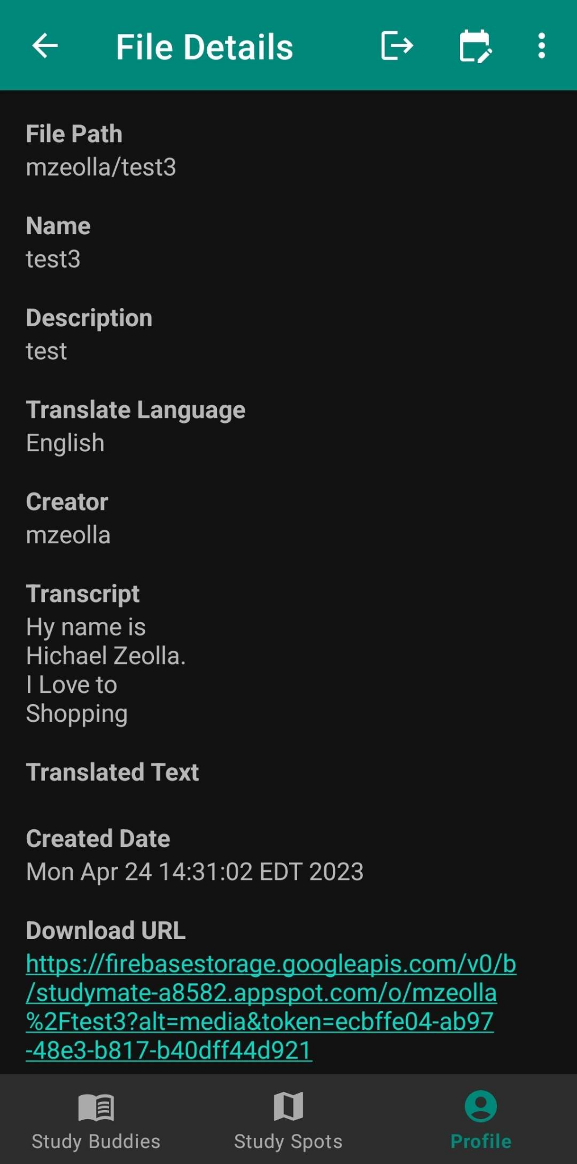
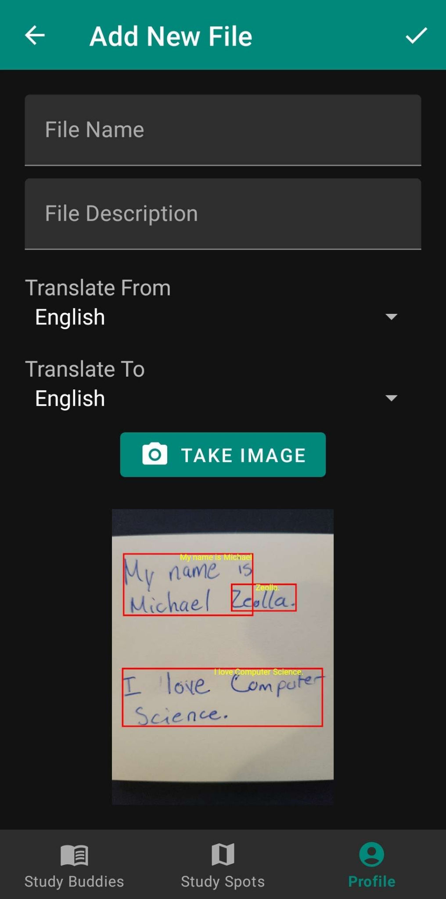
User Files - Firebase + ML Kit
Create digitized User Files of different resources
View a list of ALL files + download and share files
View a Detail View for each User File
Register new User Files using Text Recognition
Translate files to alternative languages with Text Translation
Notes:
-Zeolla

Slide 17
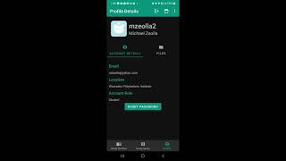
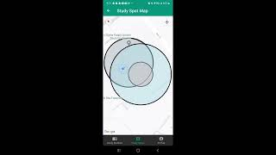
App Walkthroughs
Walkthrough
(With Explanations)
Walkthrough
(Without Explanations)
Notes:
-Zeolla

Slide 18
Ubiquitous and Mobile Computing CS 528: StudyMate
User Study and Evaluation
Notes:
‹#›
Demi

Slide 19

User Study
Test app to make sure all features work as expected
Check if app is user-friendly, easy to navigate, and if it meets the needs of students
Gather feedback from students in class to test effectiveness in grouping peers
Ask for feedback on app’s functionality, usability, and performance (UX testing)
Notes:
Demi

Slide 20
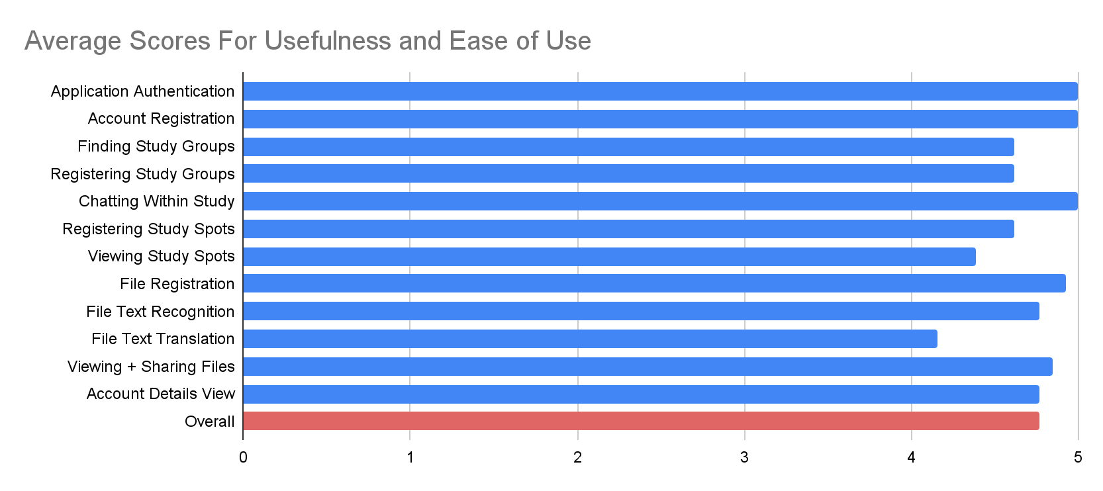
User Study Results
The use study allowed testers to rank each feature on a scale from 1-5 – 1 = bad, 5 = good
All features received an Average score between 4 and 5
Text Translation and Study Spots were the lowest ranked
User Study Average Feature Rankings
Notes:
Demi

Slide 21
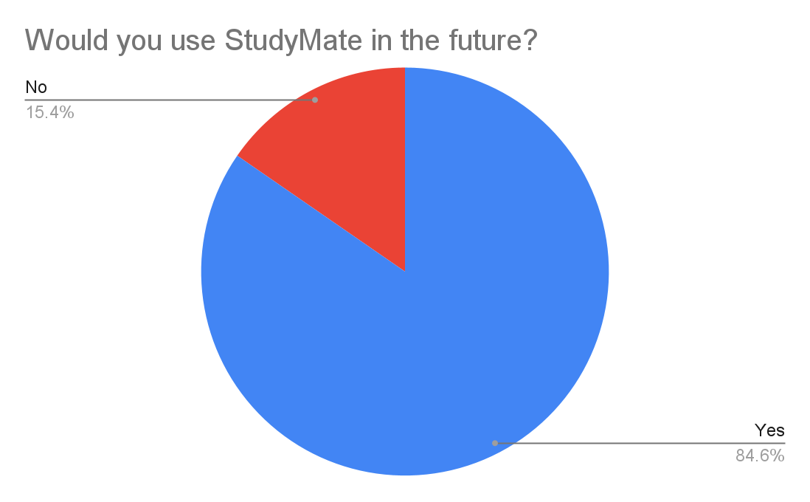
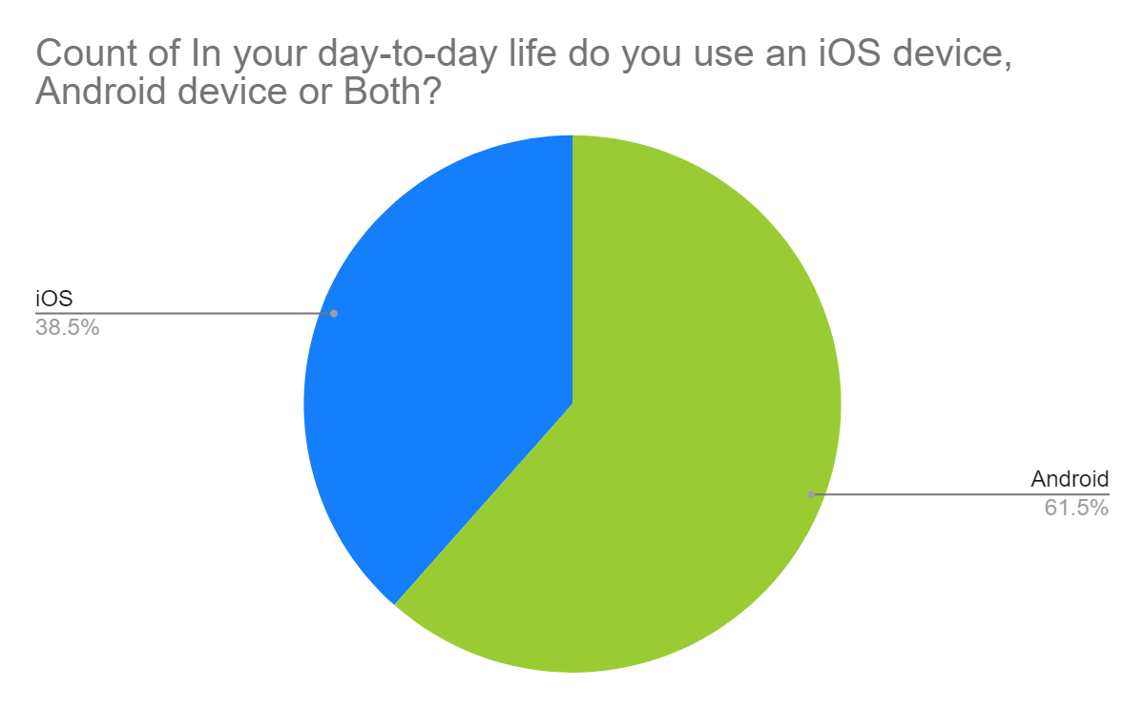
User Study Results Contd.
85% of testers indicated they would use StudyMate again
38.5% of testers indicated they own an iOS device
Unutilized market space
Future StudyMate Usage
Device Type Demographics
Notes:
Demi

Slide 22
User Study Limitations
The study only consisted of 13 total participants
Majority of testers were pooled from an Android Development course, resulting in testers being more tech savvy
Many of the participants were students at the same university
Students might feel pressured to give the app a better rating
The team encouraged testers to give critical feedback and be as harsh as necessary, to collect valuable results
Notes:
Demi

Slide 23
Ubiquitous and Mobile Computing CS 528: StudyMate
Future Work
Notes:
‹#›
Adam

Slide 24
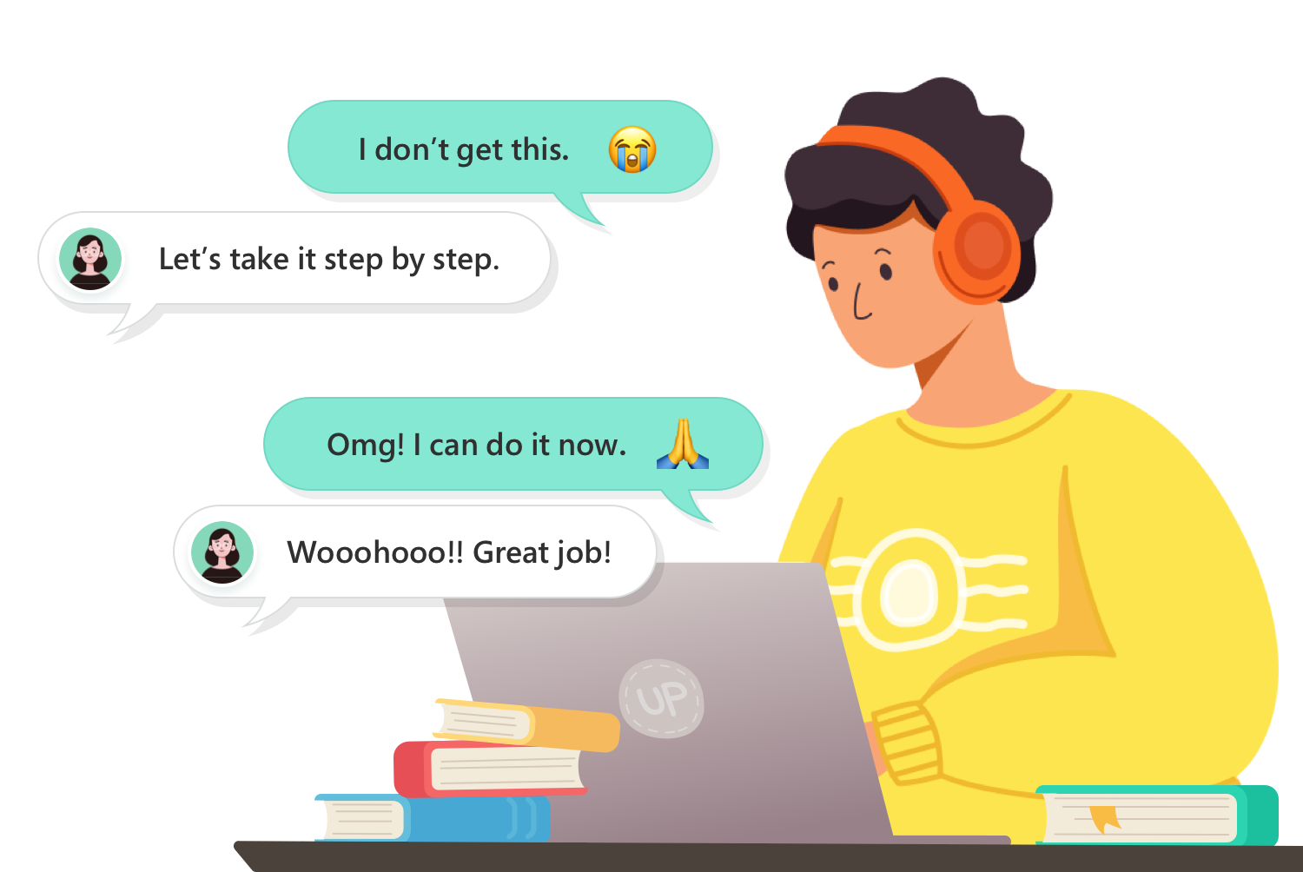
Future Works
UI Interface redesign
School-verified transcript and GPA verification
School-sanctioned tutoring service
Sharing study material within StudyMate
iOS implementation
Notes:
Adam

Slide 25
Ubiquitous and Mobile Computing CS 528: StudyMate
Conclusions
Notes:
‹#›
Roman

Slide 26
Concluding Statements
The StudyMate app is a well-rounded mobile-friendly solution to forming social bonds among peers.
It has been proven to be effective at uniting members at a university level and contains multiple features which aim to connect students and remove social barriers.
This project has shown that free technological solutions for socialization with an academic focus are possible.
Notes:
Roman

Slide 27

Difficulty Points
Difficulty Level 1 (24)
10 Android Screens (8)
Maps (4)
Location Sensing (4)
Camera: taking pictures (4)
Firebase (4)
Difficulty Level 2 (18)
GeoFencing (6)
Text Recognition (6)
Text Translation (6)

Slide 28
Ubiquitous and Mobile Computing CS 528: StudyMate
Questions?
Notes:
‹#›

Slide 29
References
Source 1: https://www.google.com/url?sa=i&url=https%3A%2F%2Fblog.planbook.com%2Fstressed-out-students%2F&psig=AOvVaw1HeywhX9sFo_xKJxzm3xlj&ust=1679524222573000&source=images&cd=vfe&ved=0CA8QjRxqFwoTCPC0rreJ7v0CFQAAAAAdAAAAABAJ
Source 2: Students continue to be stressed about college, their futures (insidehighered.com)
Source 3: https://www.wpi.edu/student-experience/resources/academic-resources-center

